Slide 1
IoT based Home Automation System
Presented By –
Noor Al Din Ahmed – 1310607043
Rahatul Aine - 1220812042

Slide 2
Introduction
IoT based home automation refers to the application of computer and information technology for control of home appliances easily from remote places.
This system allows us to program devices on the network and to remotely connect and monitor various home appliances through the internet.
Home Automation can make our life a lot easier and safer and can provide increased quality of life for the elderly or disabled persons who need caregivers.

Slide 3
Motivation
Many existing solutions are not affordable due to high cost, difficult maintenance. Many users can’t afford these costly products.
Many tasks are still repetitive in nature. For example, users switch on/off and dim lights, fans etc manually.
Many people lack knowledge for using these technologies.
Many accidents at home occur due to poor lighting condition.
Sometimes at home, the lights or fans remain switched on unnecessarily when the residents go outside their home.
So home automation products can reduce these power consumption, utility bills and automatically turn off lights and appliances when they are not in use.
Using HA system, users can check the status of their home appliances while they are away.
Our motivation - to let people know about these technologies and make the system as simple as possible for an ordinary person to understand and to facilitate the users to automate their home having remote access to the appliances and make their life convenient and comfortable.

Slide 4
Project Aim & Objective
To build a Home Automation System that will improve comfort, enhance accessibility, minimize operating costs, simplify use of technologies, and promote energy efficiency and convenience.
To enable people to monitor their home appliances in real time from anywhere in the world.
The physically challenged people can also easily control these basic appliances through a cell phone using an application.
Our system can also be used in hospitals, office buildings etc to manage certain room conditions.

Slide 5
Existing Works
Ravi Kishore Kodali et.al [1] proposed an IoT Based Smart Security and Home Automation System. He mainly focused on building a smart wireless home security system which sends alerts to the owner by using internet in case of any trespass and raises an alarm optionally.
Kumar Mandula et.al [2] proposed a solution for smart home automation using microcontrollers (Arduino) along with an Android mobile app. The device will be controlled through Bluetooth in an indoor environment and Ethernet for outdoor environment.

Slide 6
Existing Works Continues
R. Baris Dai et al [3] proposed dimmer circuit for controlling three different light sources incandescent bulb, CFL and LED and tested these different lights with AC and DC sources. Experiments were performed in order to observe the electrical characteristic of the dimmer and optical characteristic of the lighting devices when they are used with the dimmer circuit.
Jong-Hyun Kim et al [4] proposed a simple dimmer using a MOSFET for AC driven lamp such as AC LED and incandescent lamp. He proposed a new method for controlling the dimmer which is Pulse Width Modulation (PWM) method and compared the conventional phase-controlled dimmer system with his PWM method.

Slide 7
Status of Home Automation
The Zigbee home automation market is getting popular internationally. It is a wireless technology (an alternative to WI-FI and Bluetooth), supports low-cost, highly reliable networks for device-to-device communication. This allows the users to control the devices at their homes. [5]
The Ezzy Automations Ltd. is the first Home Automation solution provider in Bangladesh which enables users to access their home systems remotely from anywhere, appliances such as, lighting, temperature, security and other home devices. This automation group will be expanding in coming years. [6]

Slide 8
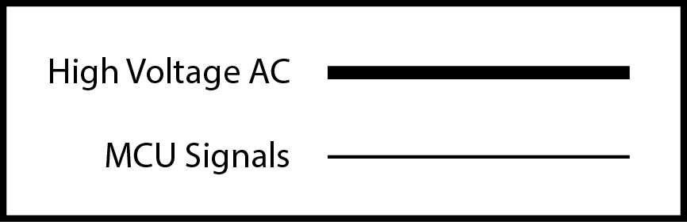
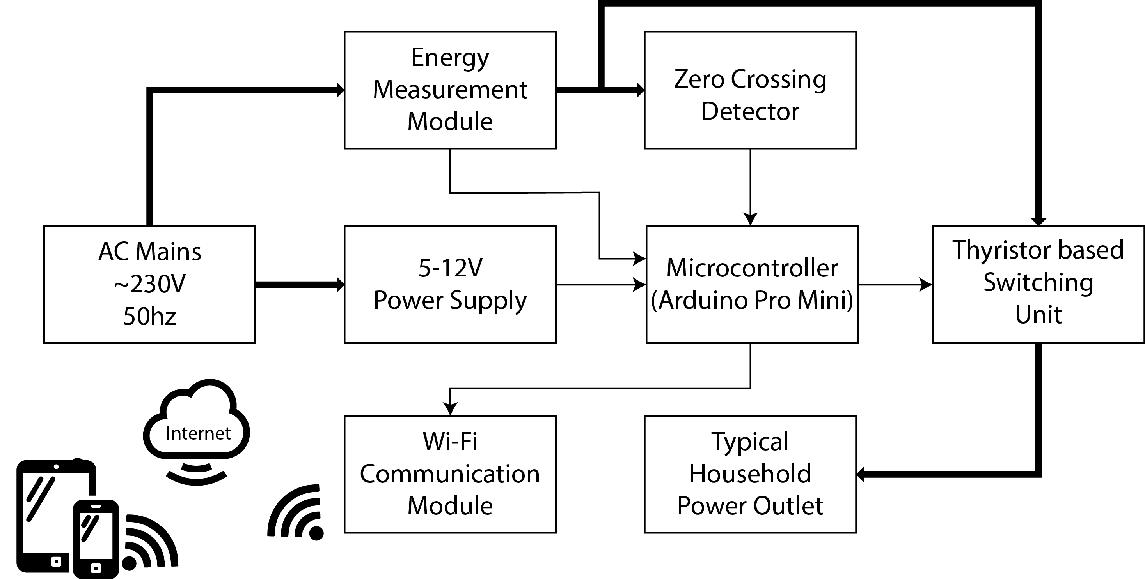
Hardware Design

Slide 9
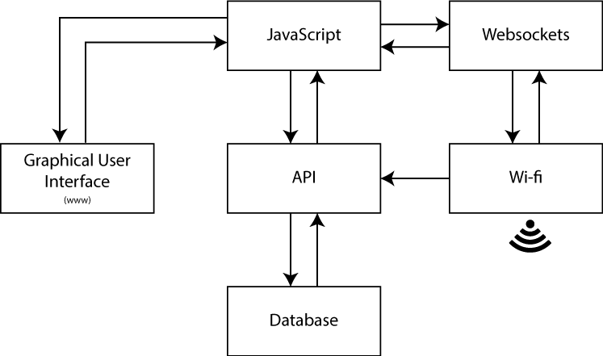
Software Design

Slide 10
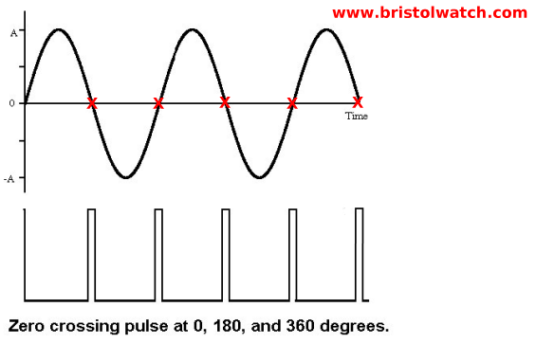
Zero Crossing Detector:

Slide 11
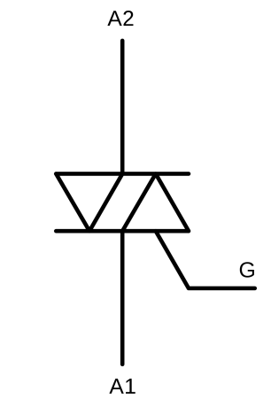
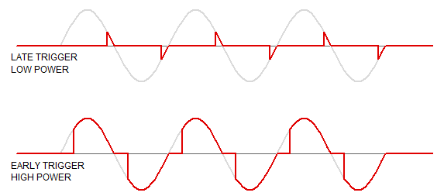
Zero Crossing Detector:

Slide 12
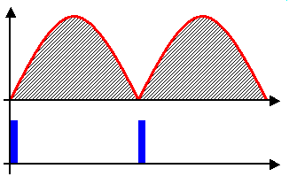
Zero Crossing Detector:

Slide 13
Zero Crossing Detector:

Slide 14
TRIAC circuit:

Slide 15
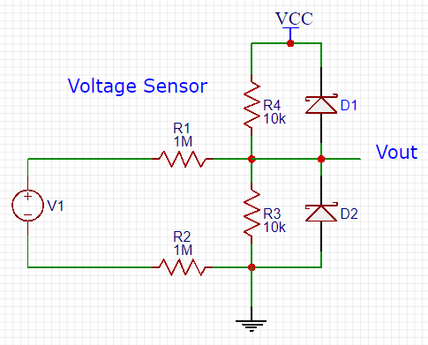
Energy Measurement:

Slide 16
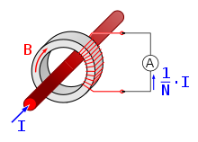
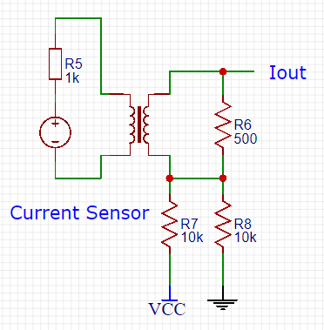
Energy Measurement:
Fig: Current Transformer

Slide 17
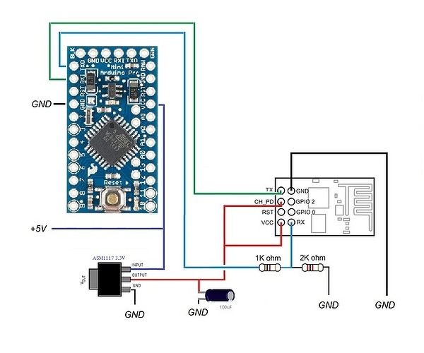
Communication Module

Slide 18

Software:
Django is a high-level Python Web framework that encourages rapid development and clean, pragmatic design. Built by experienced developers, it takes care of much of the hassle of Web development, so you can focus on writing your app without needing to reinvent the wheel. It’s free and open source.

Slide 19
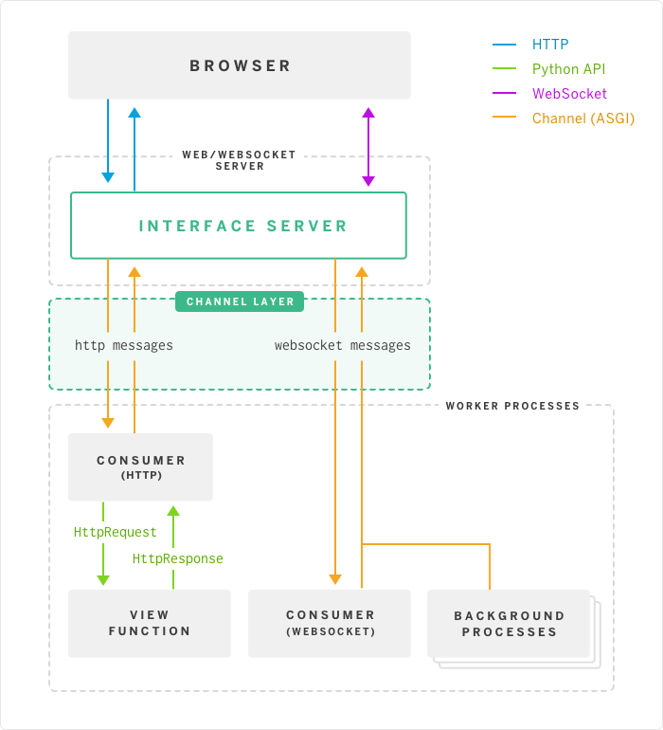
Django
Http messages are transferred and received normally through the channel layer.
Websocket messages tranfered via the producers and sent to designated consumers.
Due to websockets, message can be sent and received in real time since the port is always open.

Slide 20
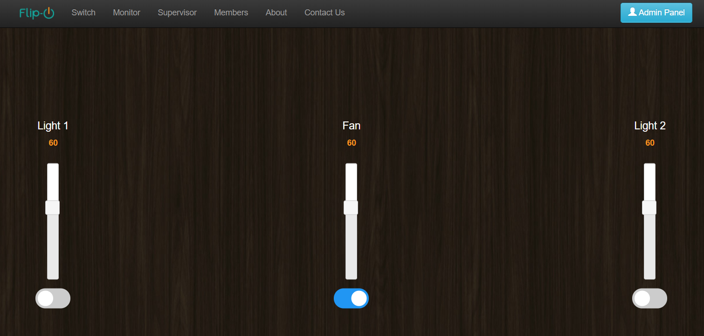
The switching Interface:

Slide 21
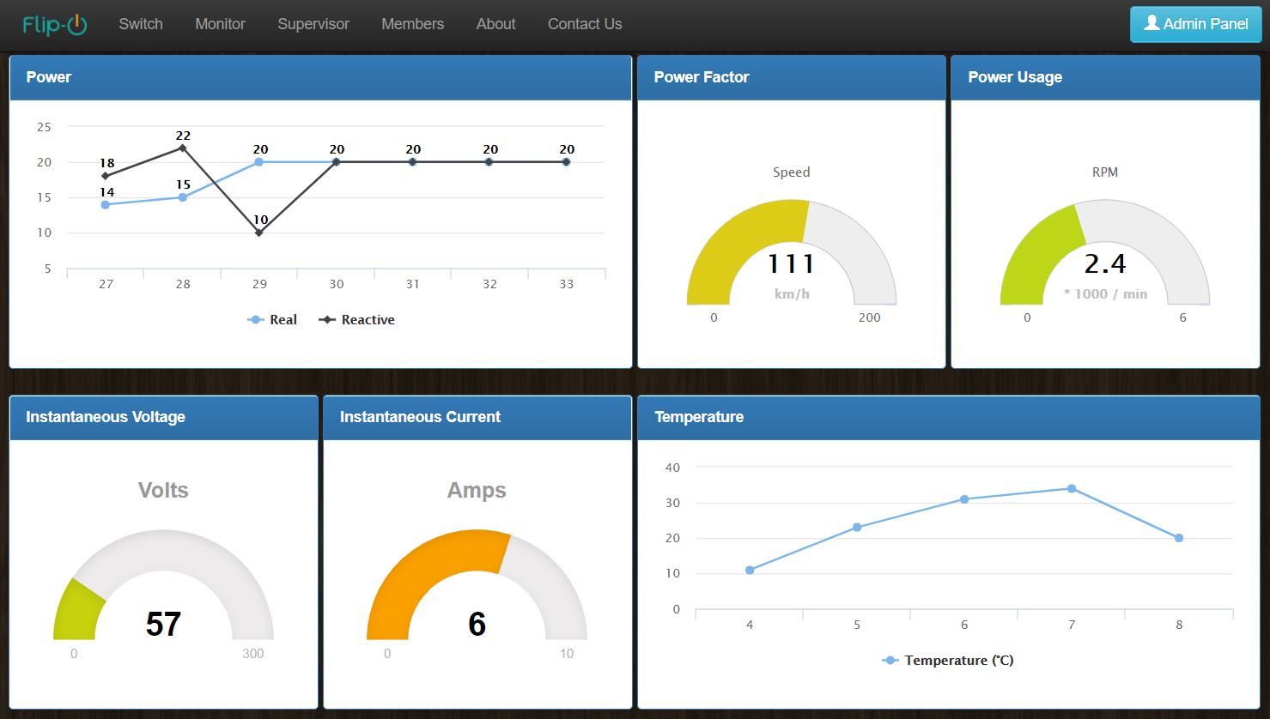
The power monitoring Interface:

Slide 22
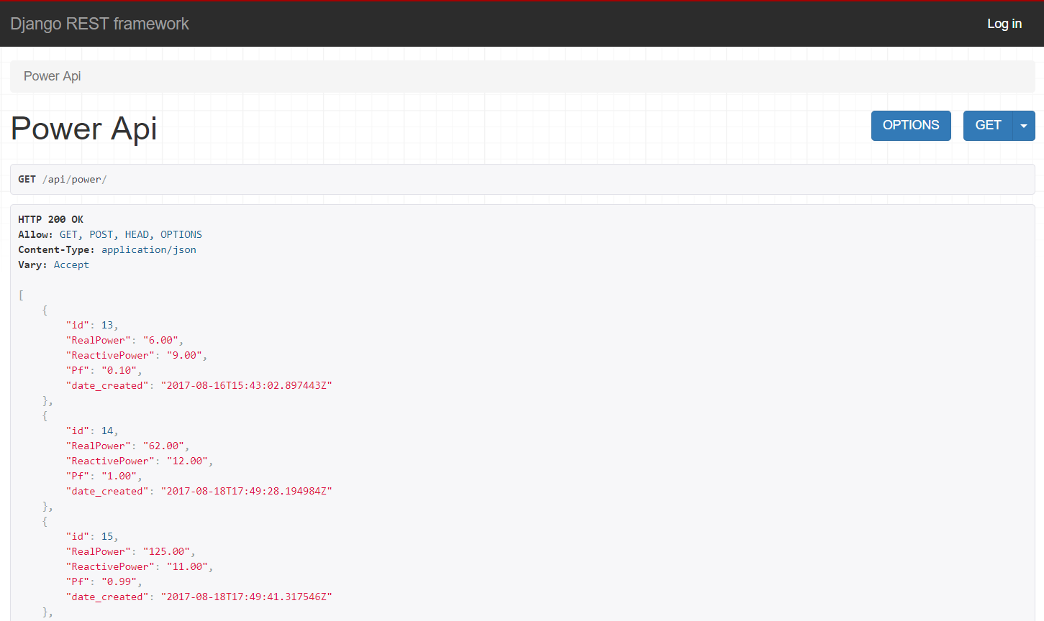
The API Interface:

Slide 23
Results
Raw Zero Crossing Detector Output from Arduino:

Slide 24
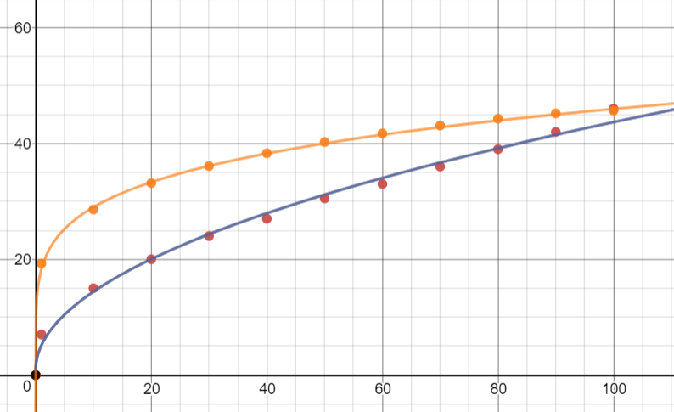
Results
Current Sensor Comparison with traditional Ammeter
A
True RMS
(Our System)
Average Current
(Ammeter)
Phase delay

Slide 25
Cost Analysis
Materials | Quantity | Price(Taka)
Arduino Pro Mini | 1 | 180
ESP8266 (01) | 1 | 220
Current Transformer | 1 | 125
5.1V Zener Diodes | 2 | 6
BTA-04 600B | 3 | 150
MOC3021 | 3 | 45
Full Bridge Rectifier | 1 | 16
EL817 Optocoupler | 1 | 4
LM311 Comparator | 1 | 15
NPN transistor 2N2222A | 1 | 1
Diodes, Resistors, Capacitors | 33 | 50
Terminal Blocks | 7 | 28
PCB | 3 | 250
Headers | 1 | 10
Total |  | 1100
Approx.
1100tk
Per unit
Cost !!

Slide 26
Limitations
Not compatible with CFLs and regular LED bulbs.
No security features has been added to the web server as of yet. At the moment, there is no authentication system implimented, so the whole system is prone to security risks.
This module is rated for 240V, 4A AC power systems only.

Slide 27
Future Work
Security issues need to be sorted.
Using MOSFETS instead of TRIACS for better efficiency.
More features to be added such as, motion sensors, cameras and Artificial Intelligence.
Make it more optimum for LED lights.
Make it modular. User can add on more units to existing ones under the same network.
Implementing power factor correction for energy saving applications.

Slide 28
Conclusion
Primary objective of our project is to enable people to control their electrical devices via these Home Automation devices from remote areas.
To build a product which will be affordable for users.
In future, this product may have high potential for marketing.

Slide 29
References
1. IoT Based Smart Security and Home Automation System - Ravi Kishore Kodali, Vishal Jain, Suvadeep Bose and Lakshmi Boppana Department of Electronics and Communications Engineering National Institute of Technology, Warangal.
2. Mobile based Horne Automation using Internet of Things(IoT) - Kumar Mandula, Ramu Parupalli, CH.A.S.Murty, E.Magesh, Rutul Lunagariya Centre for Development of Advanced Computing(C-DAC) A Scientific Society under Ministry of Communications and Information Technology, Government of India mkumar@cdac.in, ramup@cdac.in, chasmurty@cdac.in, magesh@cdac.in, rutul.lunagaria@gmail.com.
3. https://www.achrnews.com/articles/133443-zigbee-home-automation-market-to-grow-at-26-cagr-to-2020
4. http://www.ezzyautomations.com/about-us/

Slide 30
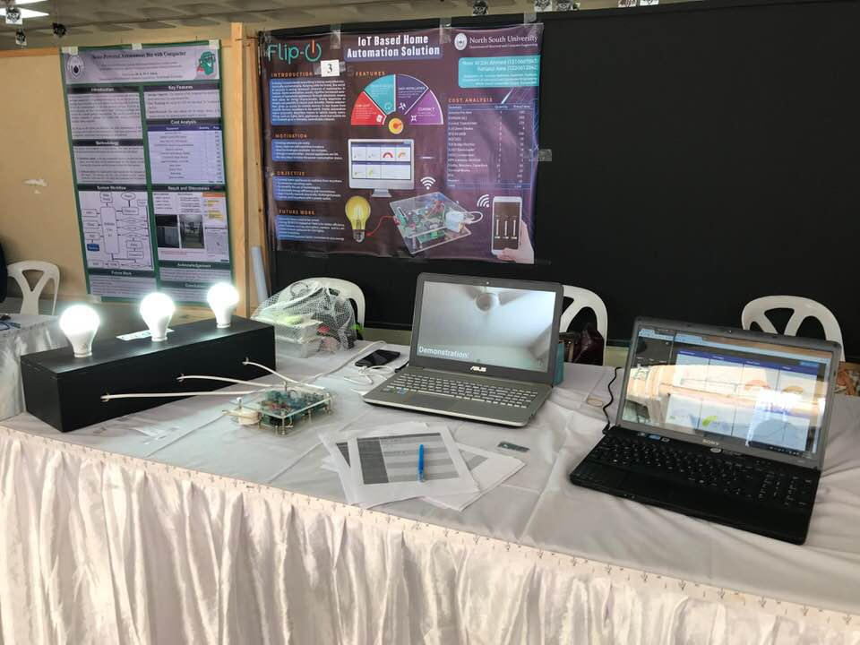
Notes:
Capstone Fall 2017 Stall

Slide 31
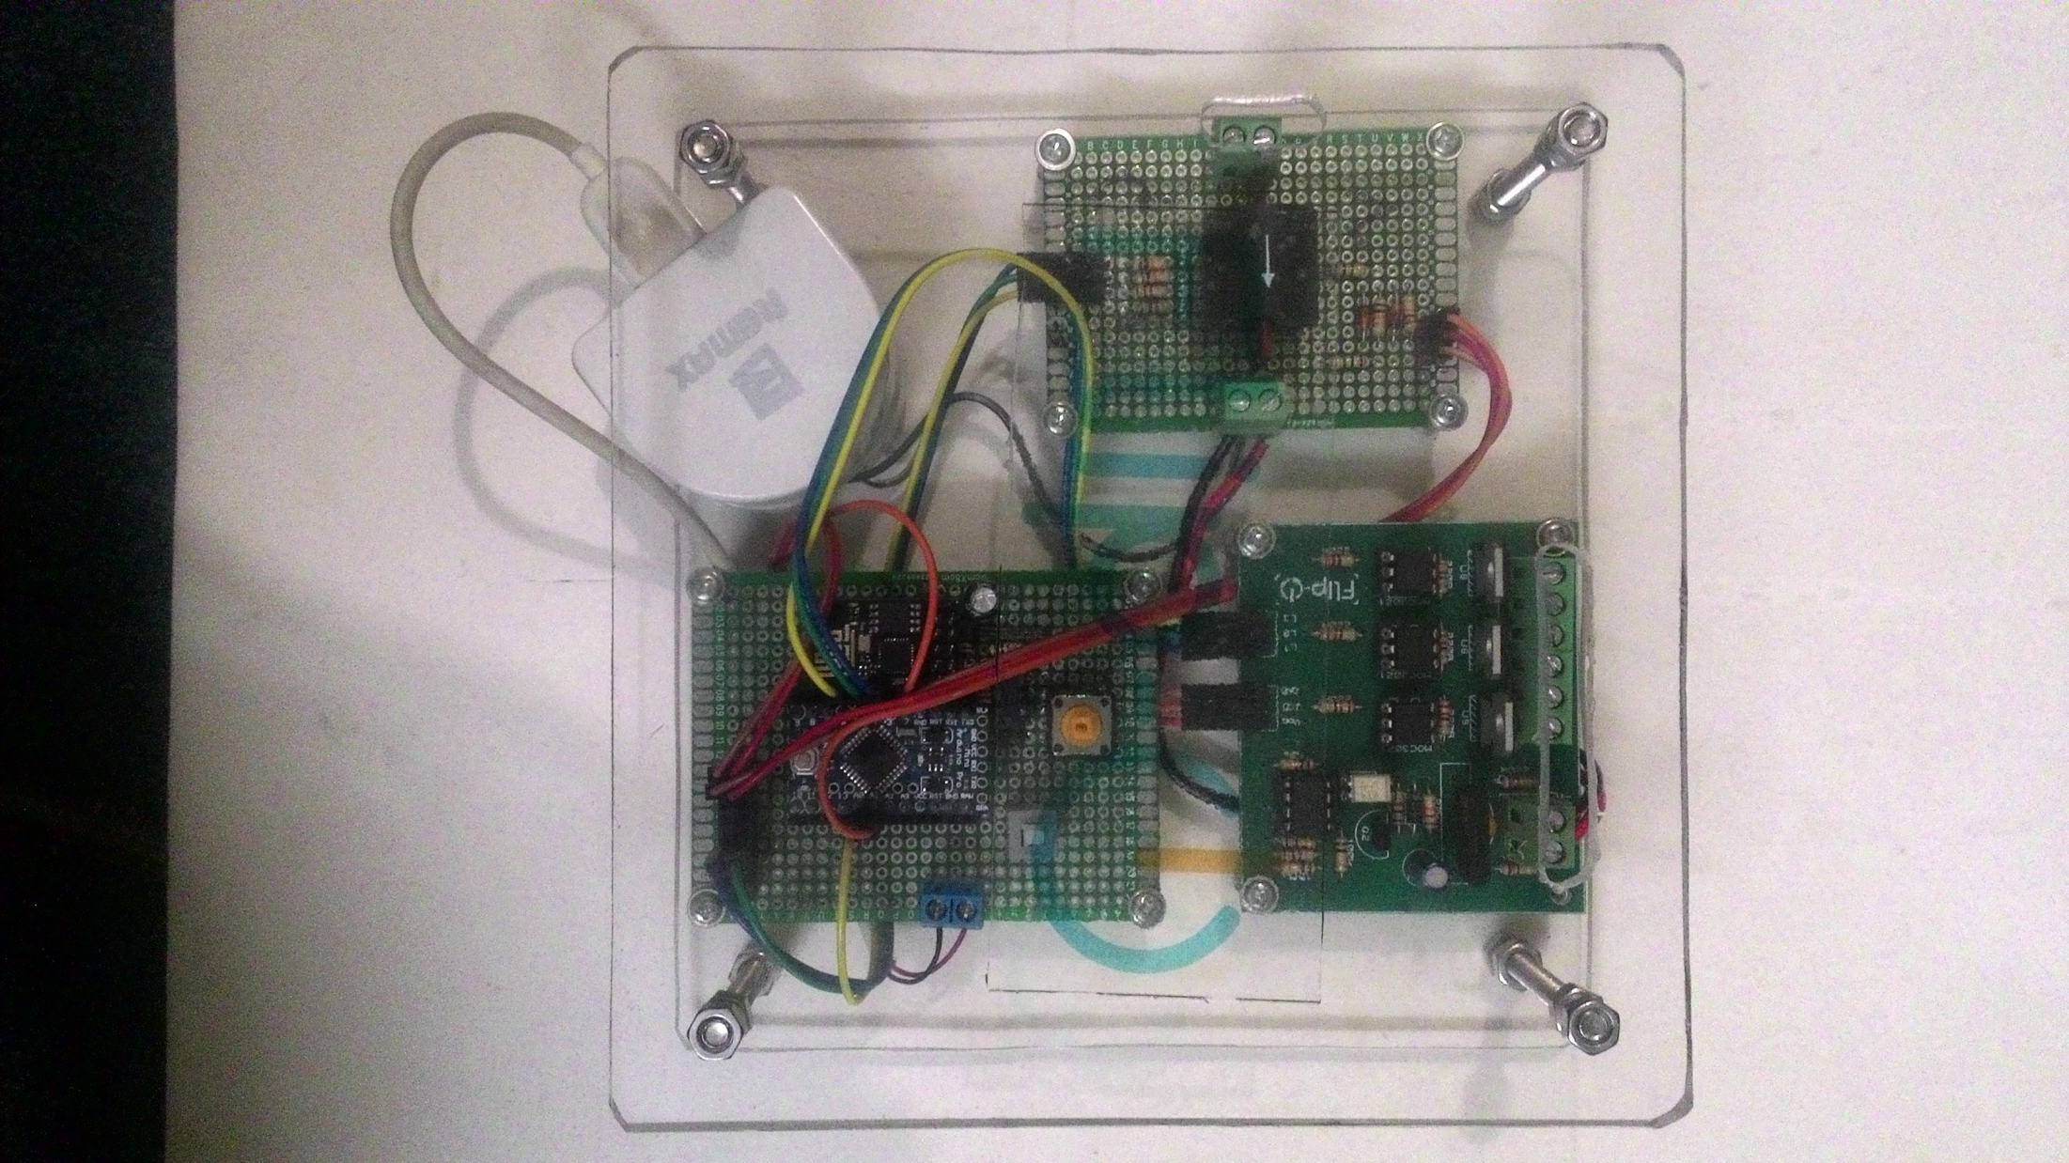

Slide 32
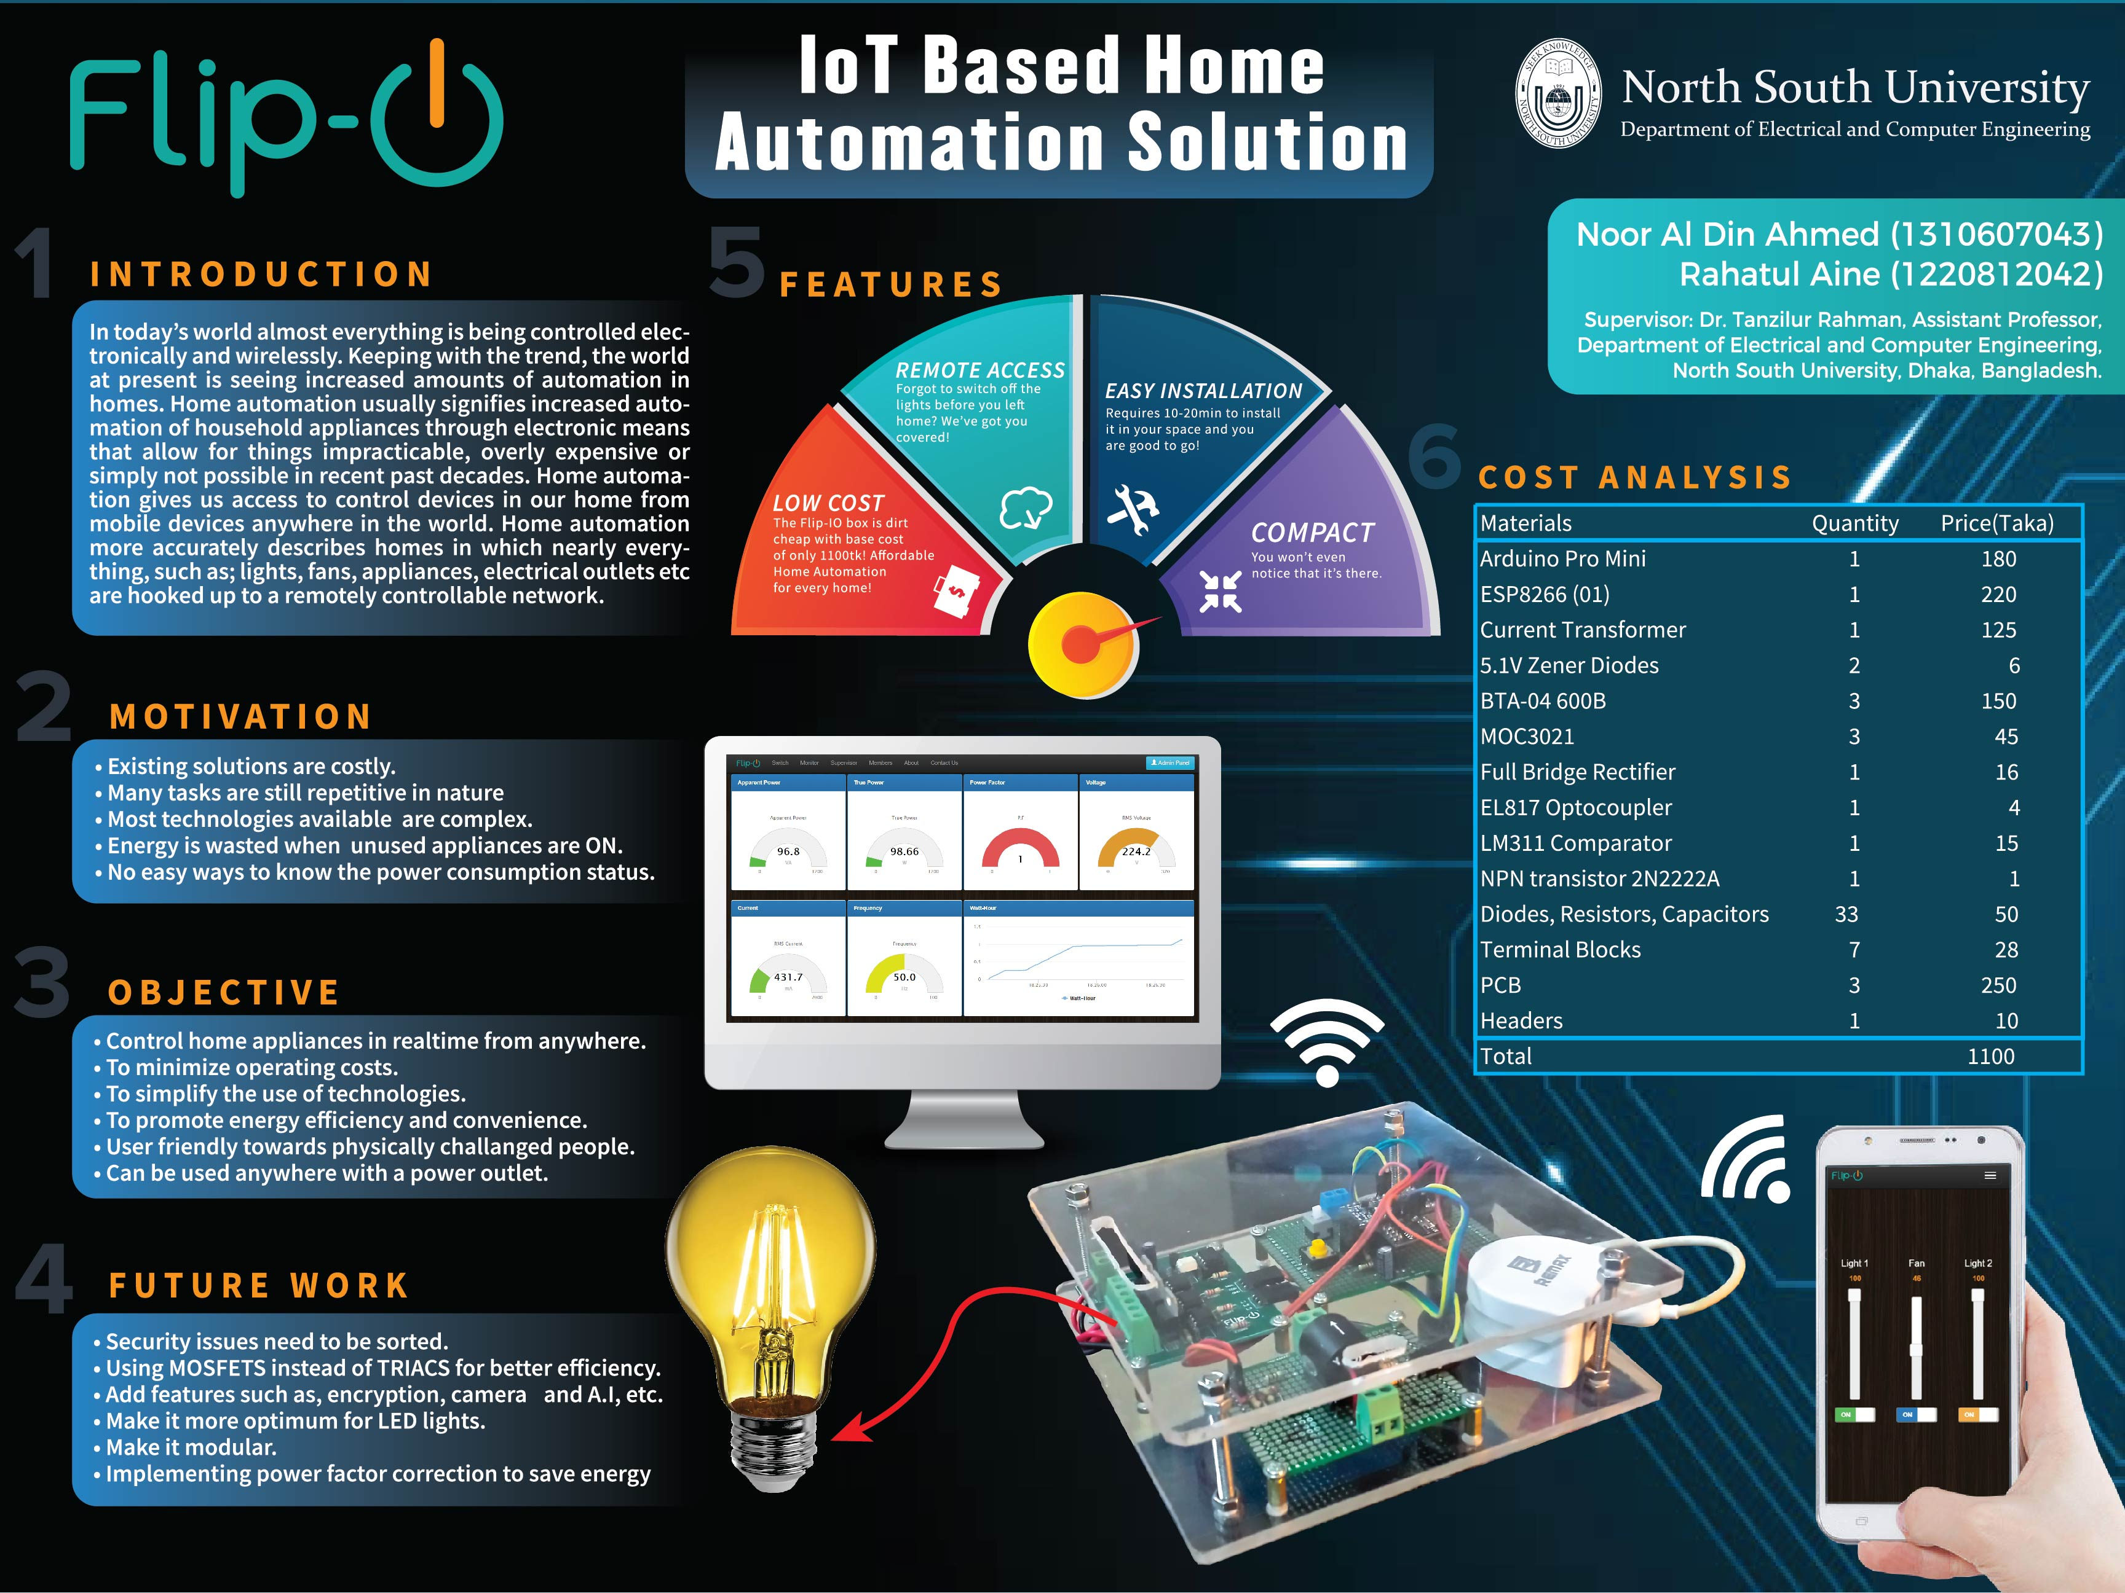
Notes:
Capstone Fall 2017 Poster

